Slide 1
3-Level NPC Inverters
Thesis: DC-LINK CAPACITOR SIZING OF THREE-LEVEL NEUTRAL POINT
CLAMPED VOLTAGE SOURCE INVERTERS FOR VARIABLE SPEED DRIVES

Slide 2
Advantages & Disadvantages
Advantages against 2-Level Inverter:
- Efficiency
- 1/2Vdc voltage stress
Disadvantages against 2-Level Inverter :
- Complexity
- Unequal Power Loss

Slide 3
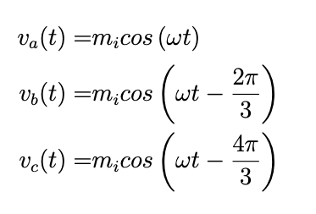
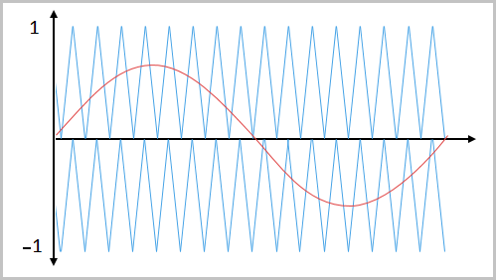
Sinusoidal PWM
Phase voltages (reference signals);
Two triangular carrier signal
[0,Vdc/2] & [-Vdc/2,0]
Peak amplitude=Vdc/2

Slide 4
Sinusoidal PWM
State | Q1 | Q2 | Q3 | Q4
Carrier1<reference Carrier2<reference | ON | ON | OFF | OFF
Carrier1>reference Carrier2<reference | OFF | ON | ON | OFF
Carrier1<reference Carrier2>reference | OFF | ON | ON | OFF
Carrier1>reference Carrier2>reference | OFF | OFF | ON | ON

Slide 5
Sinusoidal PWM
This method does not control the neutral point.
Large capacitors needed.

Slide 6
SVPWM

